Slide 1
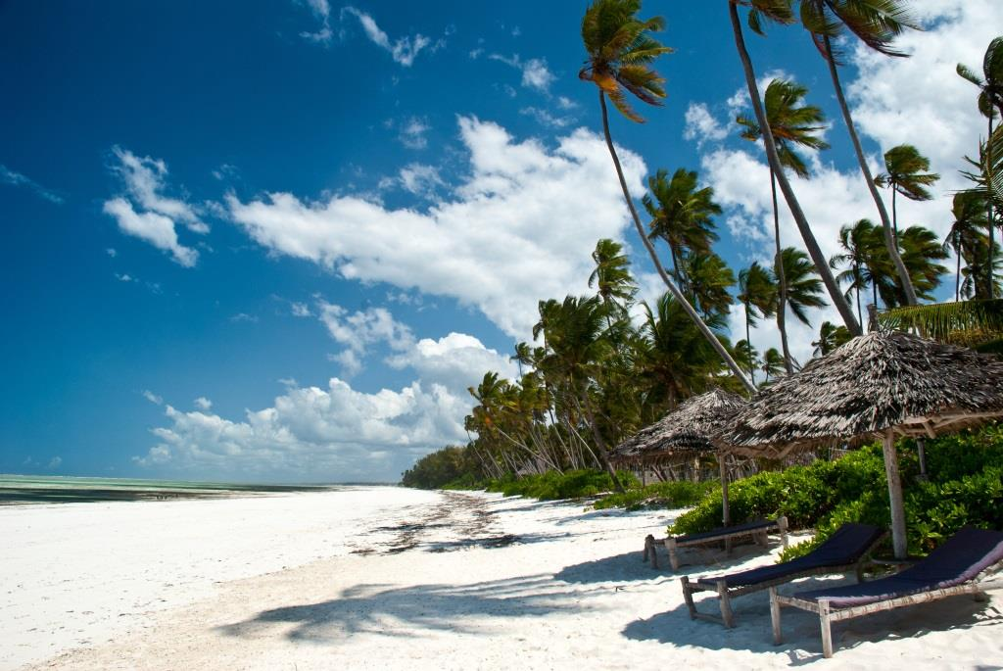
Reggae Music
Cross Oceans Music

Slide 2
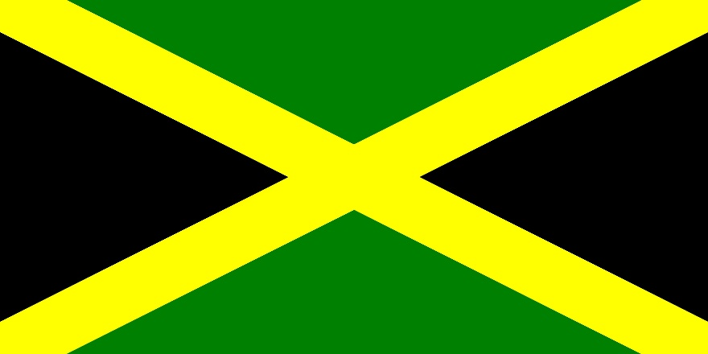
Origins
Cultural
Jamaica
Derivative Forms
Ska
Rock Steady
Associated with the Rastafari Movement

Slide 3
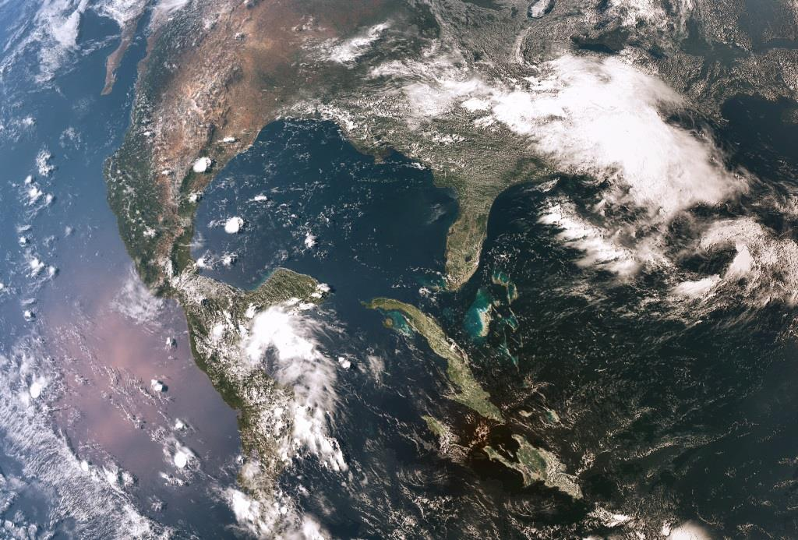
Derivative Forms
Ska
Elements of Calypso
Caribbean Mento
American Jazz
Rhythm and Blues
Rock Steady
Slower
Languid
More Syncopated

Slide 4
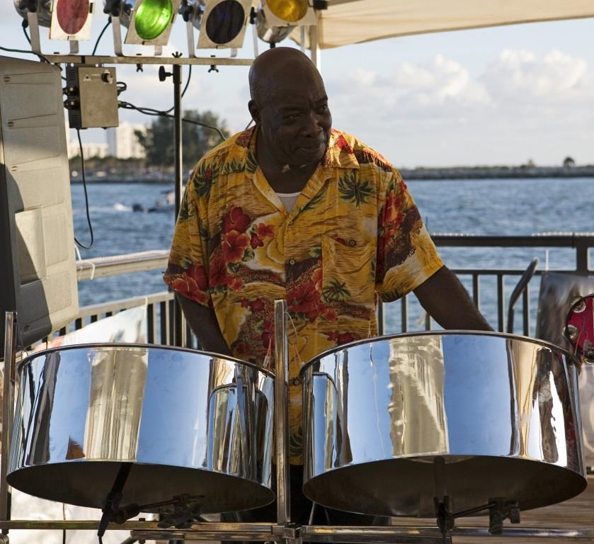
Other Reggae Forms
Lovers Rock
Melodic
Romanticized
Dub
Purely Instrument
“Dubbed Over” by Jamaican DJs
Dancehall Reggae
Similar to Rap

Slide 5
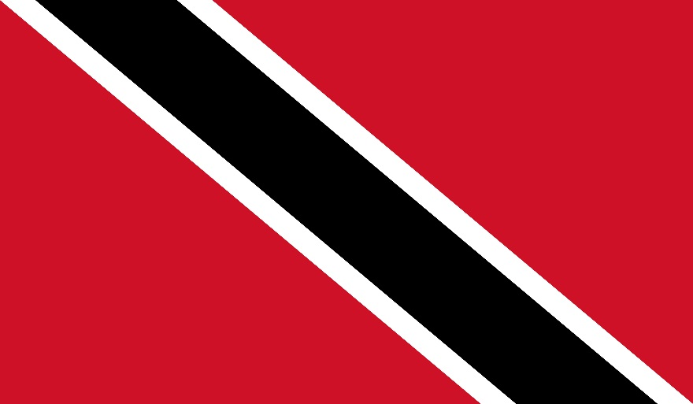
Trinidad Forms
Soca
Fast-paced
Played in Upscale Discos
Calypso
Fast-paced
Features Steel Drums

Slide 6
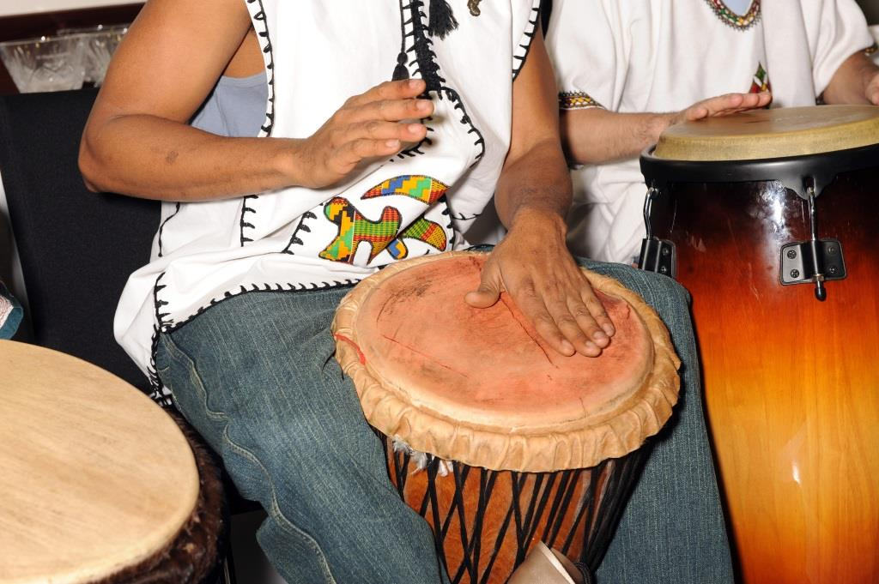
Rhythm Style
Skank
Regular Chops on the Off-Beat
Slower than Ska or Rock Steady

